Slide 1

Comprehensive Analysis of Tredence in the Data Analytics Industry
A detailed examination of Tredence's market position, services, and competitive landscape in the global data analytics sector

Slide 2

Company Profile
Who is Tredence?
Company Overview
Tredence is a global data science and AI solutions provider founded in 2013 by Shub Bhowmick, Sumit Mehra, and Shashank Dubey. Headquartered in San Jose, California, the company is specialized in solving the "last-mile problem" in AI—the critical gap between insight creation and value realization.
With over 3,500 employees across 10+ global delivery centers including San Jose, Chicago, London, Toronto, Dubai, and Indian centers in Bengaluru, Chennai, Gurgaon, Pune, and Kolkata, Tredence has become a recognized leader in enterprise data analytics and AI solutions.
Mission and Approach
Tredence's core mission is to empower decisions that help clients win by bridging the gap between insights delivery and value realization. The company operates on a vertical-first approach with deep domain expertise across retail, CPG, telecom, healthcare, travel & hospitality, financial services, and manufacturing. Unlike traditional analytics providers that focus solely on insight generation, Tredence emphasizes operationalizing insights to drive tangible business impact.

Slide 3

Company Status and Growth
$795M
16%
$175M
$205M
Annual Revenue
YoY Employee Growth
Series B Funding
Total Funding
Estimated annual revenues ranging from $250M to $794.7M across varying sources
Targeting 1,700 new hires in 2025 to reach approximately 6,000 employees total
Raised from Advent International in 2022 at a $500 million valuation
Total funding raised since inception
Growth Trajectory
The company achieved 40-50% revenue growth targets and maintains profitability without funding needs until 2027.

Slide 4

Market Position
Ranking and Positioning in Global Data Analytics
Analyst Recognition
Tredence holds significant industry standing through prestigious analyst recognition:
Forrester Wave: Customer Analytics Services Q2 2025
Everest Group: Data and AI Services Specialists – North America PEAK Matrix 2025
ISG Provider Lens: Data and AI Services Specialists 2024
Named a Leader with the highest possible scores of 5/5 in 15 criteria, praised as "best in class for companies looking for end-to-end CXM transformation, speed to insights, and superior last-mile adoption"
Positioned as a Leader among 19 qualified providers out of 77 companies assessed
Recognized as a Leader and Star Performer among 32 evaluated providers, noted for design thinking, technical expertise, unique IP approach, and strong hyperscaler partnerships
Global Market Position
In the broader data analytics market, Tredence ranks among the top specialized providers but operates below the mega-consultancies like Accenture, Oracle, and IBM. Among mid-market and specialist analytics firms globally, Tredence competes with peers including Fractal Analytics ($1.94 billion revenue, 6,172 employees), Tiger Analytics ($2 billion revenue, 6,367 employees), Mu Sigma ($784.6 million revenue), and ZS Associates ($4.16 billion revenue).

Slide 5
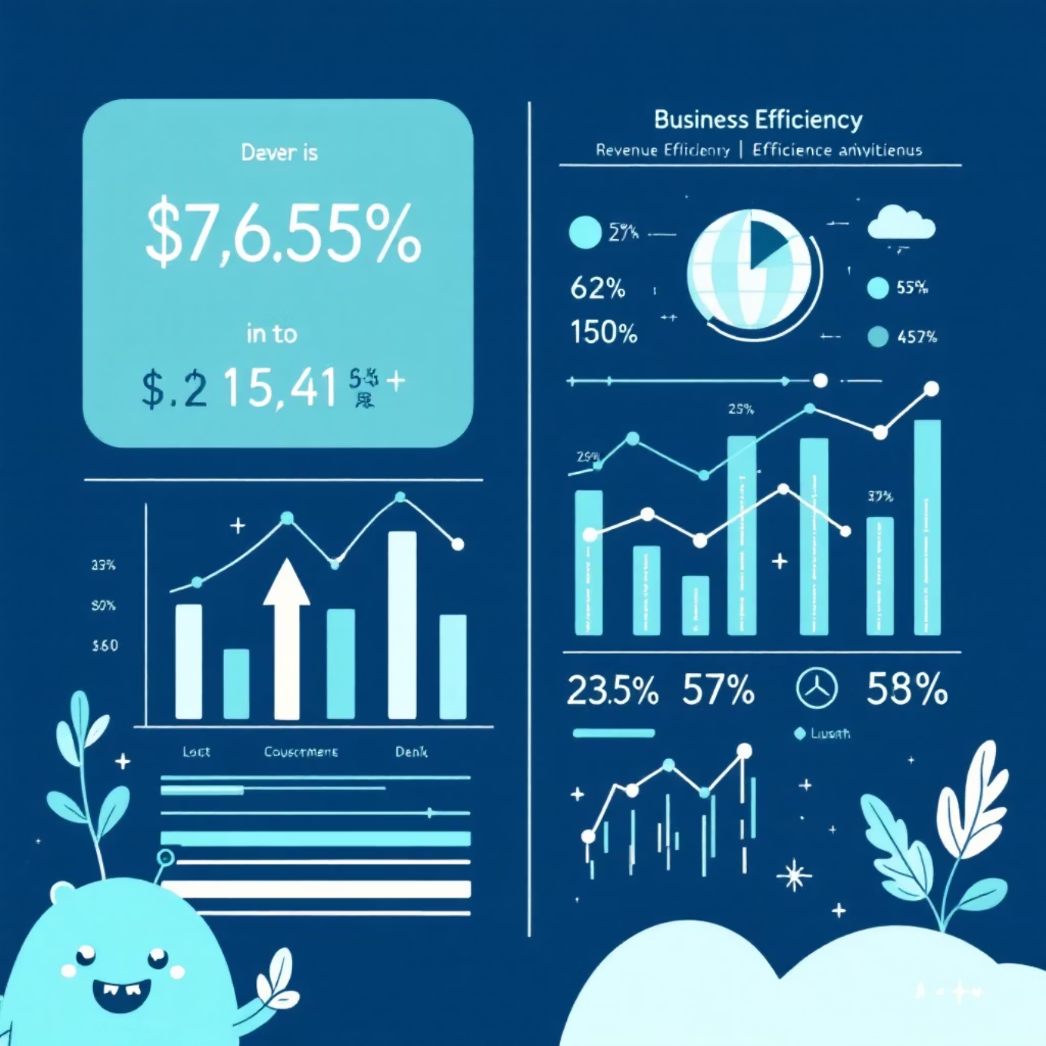
Revenue Comparison with Evalueserve
Revenue Analysis
Company
Estimated Annual Revenue
Employee Count
Revenue per Employee
Evalueserve
$928.5M - $945.2M
6,311
$142,800
Tredence
$794.7M
2,526
$314,600
Comparative Positioning
Evalueserve is larger in overall revenue (~17% higher), but Tredence demonstrates superior revenue per employee (2.2x higher), indicating a more efficient business model focused on higher-value services rather than volume-based delivery.
Evalueserve's larger workforce reflects its broader service portfolio extending beyond analytics into market research, competitive intelligence, and compliance domains.

Slide 6
Service Portfolio
Data Analytics Services Offered by Tredence
Tredence's data analytics services span across the entire value chain:
1
2
3
Advanced Analytics & Data Science Services
Data Engineering Services
Customer Experience Management (CXM)
Data migration and modernization
Custom machine learning models development
Cloud data architecture design
Customer data platform implementation
Predictive and prescriptive analytics
ETL/ELT pipeline development
Customer journey mapping and analytics
Statistical analysis and forecasting
Data governance and quality frameworks
Personalization and segmentation models
Optimization algorithms
Real-time data streaming capabilities
Loyalty analytics
Omnichannel customer orchestration
Voice of customer analytics
4
5
Industry-Specific Solutions
Data Architecture & Modernization
Retail: Demand forecasting, inventory optimization, pricing strategies, store performance analytics
Cloud migration services (AWS, Azure, GCP, Snowflake)
CPG: Trade promotion management, revenue growth management, supply chain analytics
Data lake and data warehouse implementation
BFSI: Risk analytics, compliance automation, customer lending analytics, fraud detection
Legacy system modernization
Healthcare: Patient journey analytics, operational efficiency, predictive health analytics
Manufacturing: Production optimization, predictive maintenance, supply chain intelligence
Telecom/Travel: Churn prediction, customer lifetime value optimization

Slide 7

Pricing Strategies for Data Analytics Services
Pricing Model Information
Tredence employs multiple pricing approaches, though the company does not publicly disclose detailed pricing structures. Available insights indicate:
Flexible Engagement Models
Factors Affecting Price
Project-based pricing: Custom quotes based on scope, complexity, and timeline
Engagement duration (ranging from weeks to multi-year transformations)
Time and materials: For exploratory and evolving engagements
Data complexity and volume
Outcomes-based/Value-based pricing: Aligning fees with business results delivered (similar to ZS Associates model)
Industry vertical (financial services often commands premium rates)
Geographic delivery (onshore vs. offshore resource mix)
Annual licensing: For platform-based solutions with monthly payment options available through financing partners like Capchase
Technology stack and partnerships involved (GCP, Databricks, Snowflake partnerships influence cost structures)
No Public Pricing Disclosure: Unlike SaaS platforms, Tredence requires direct engagement with sales teams for customized quotes, reflecting its enterprise consulting nature.

